Slide 1
Configuration Lab Database Project
Josh Poston

Slide 2
Purpose
To allow the user to track the inventory of the Configuration Lab. The database stores information about the various items, the supplier of those items, and the destinations (plants) for those items.
The database is designed to prompt the user for a password, and then direct them to a Homepage that houses links to perform various queries and reports.

Slide 3
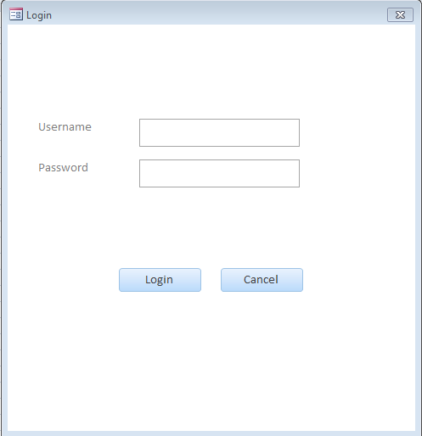
Opening The Database
When the user first opens the database, they are prompted with a username/password prompt.

Slide 4
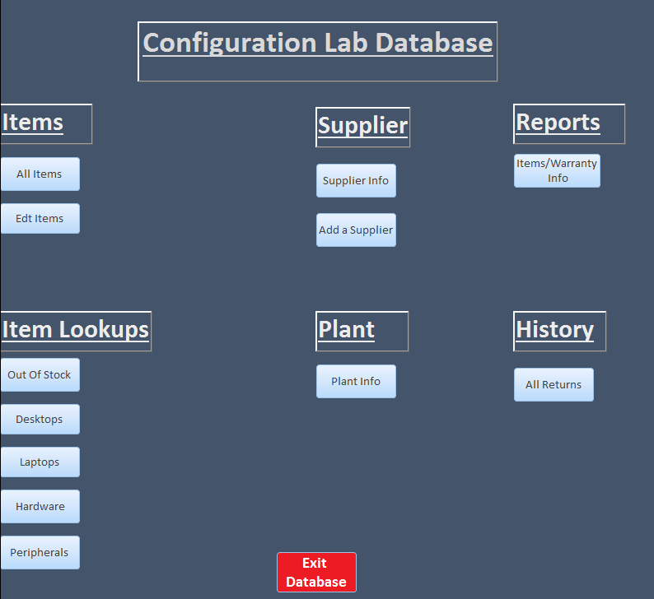
Logging In Takes You To The Homepage
The Homepage contains a series of buttons that allows the user to run queries, reports, and add/remove items from the inventory.

Slide 5
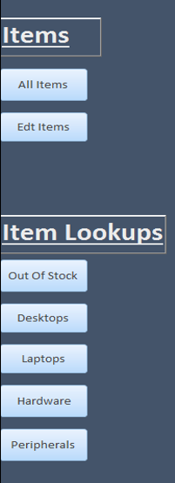
Items
These menus & buttons allow you to:
Run queries about specific types of items (i.e. Hardware, Desktops, etc…)
Run a current inventory query
Add/remove items from the inventory

Slide 6
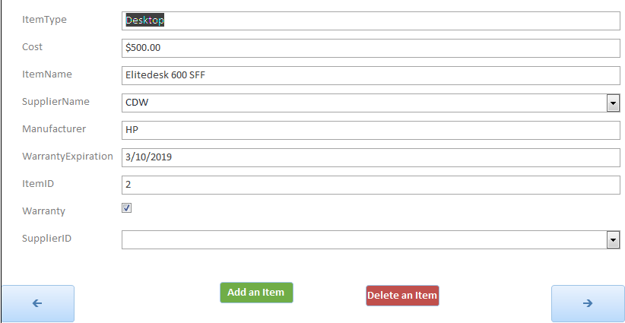
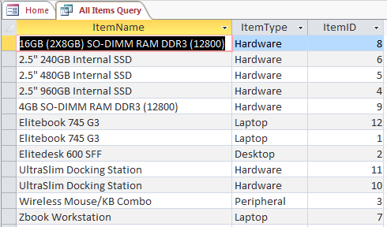
All Items
Edit Items

Slide 7
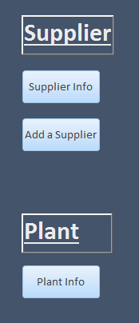
Suppliers & Plants
These sections allow you to:
Add/remove Suppliers
Query the Suppliers that are currently in the database
View all Plants and their specific information (i.e. Contact person, address, ChargeCode etc…)

Slide 8
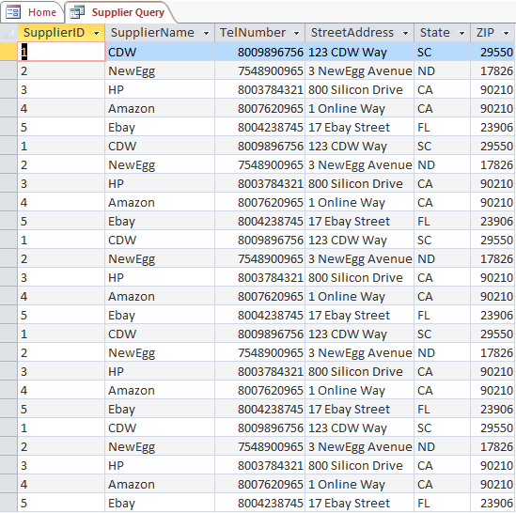
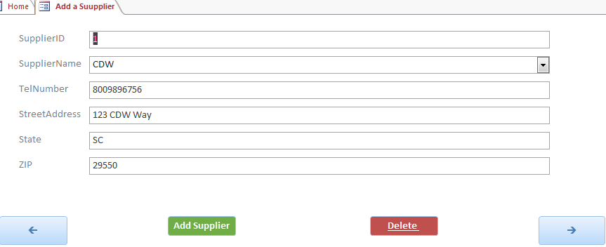
Supplier Info
Edit Supplier

Slide 9
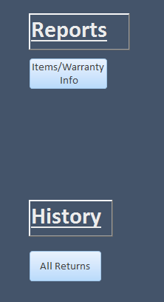
Reports & History
These sections allow you to:
Run a report that provides each item’s specific information (including their warranty status).
Query all returns of inventory from plants.

Slide 10
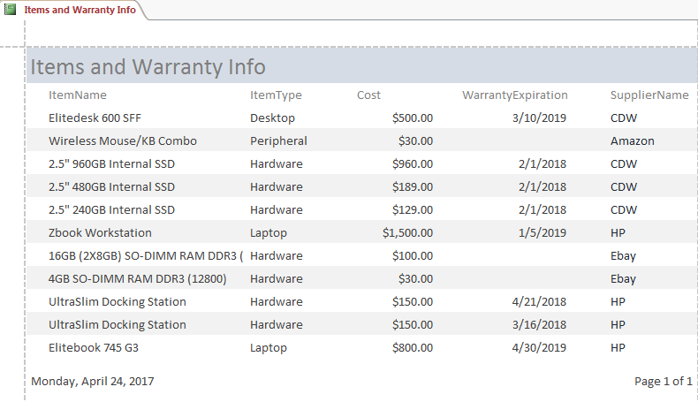
Items & Warranty Info Report

Slide 11
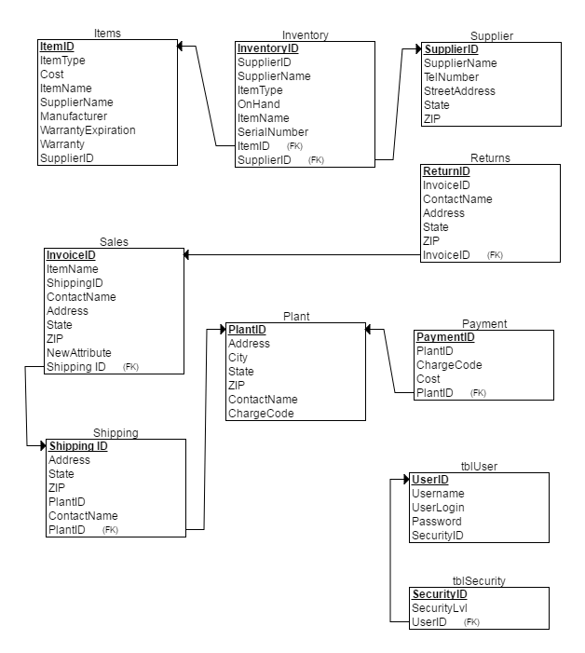
ERD

